Slide 1
COMS 4111: Introduction to Databases Lecture 1: Introduction, Assignment 1a
Dr. Donald F. Ferguson
dff9@columbia.edu

Slide 2
Contents

Slide 3
Contents
How will we learn it?
Course Overview, Organization and Logistics
Data, Data Models, Databases, Database Management Systems Overview
Lets’ learn something
Data Modeling (I) – Entity, Relationship, Attribute
Relational Data Model (I) – DDL, DML, Table, Tuple, Column
1st Assignment
What will we learn and why?
Cool!
Will likely not get to until next lecture.
Oh Cr*p!

Slide 4
Course Overview, Organization and Logistics

Slide 5
Your Instructor

Slide 6
A Little About Me
Columbia through and through
BA (Columbia College) ‘82, M.S. ’84 (Engineering), M.Phil. ‘84 (GSAS).
Ph.D. ‘87 (GSAS) – Thesis: “The Application of Microeconomics to the Design of Resource Allocation and Control Algorithms.”
Adjunct Professor at Columbia Univ: 2006, 2009, 2014-2017. 7 “Topics in CS” courses.
32 years of technology contribution and leadership.
VP, IBM Fellow: IBM Research, IBM Software Group.
Microsoft Technical Fellow.
Distinguished Engineer, CTO, Executive VP, CA technologies.
VP, Sr. Fellow, CTO, Dell Software Group.
Co-Founder, CTO Seeka TV (www.seeka.tv).
Personal
Two fantastic daughters; high school and one is a senior at Barnard.
Black belt in Kenpo Karate (http://www.tracyskarateworldwide.com/about.html, www.elitedefensivetactics.com )
2LT in New York Guard (http://dmna.ny.gov/nyg/)
Conversational Spanish, learning Arabic
Hobbies: Bicycling, Astronomy

Slide 7
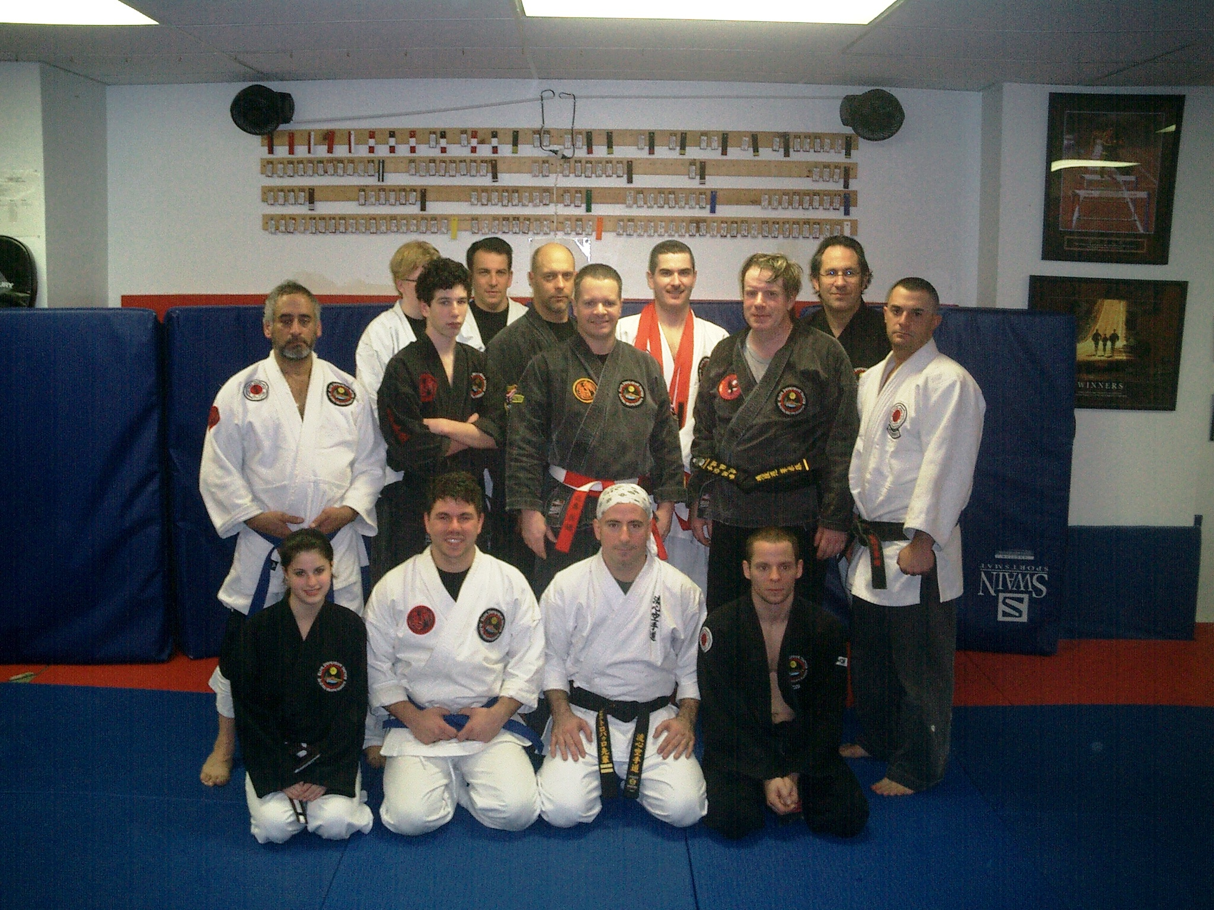
A Little About Me
Columbia through and through
BA (Columbia College) ‘82, M.S. ’84 (Engineering), M.Phil. ‘84 (GSAS).
Ph.D. ‘87 (GSAS) – Thesis: “The Application of Microeconomics to the Design of Resource Allocation and Control Algorithms.”
32 years of technology contribution and leadership.
IBM Fellow: IBM Research, IBM Software Group.
Microsoft Technical Fellow.
Distinguished Engineer, CTO, Executive VP, CA technologies.
Sr. Fellow, CTO, Dell Software Group.
Co-Found, CTO Seeka TV.
Personal
Two daughters
Black belt in Kenpo Karate
2LT in New York Guard (http://dmna.ny.gov/nyg/)
Conversation Spanish, learning Arabic
Hobbies: Bicycling, Astronomy

Slide 8
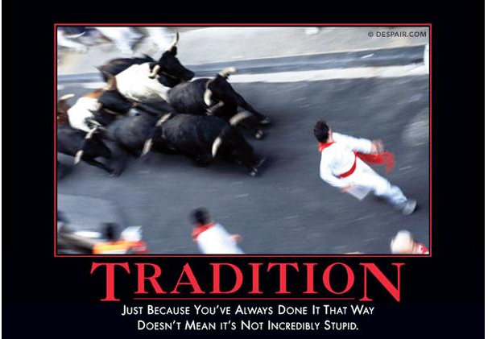
A Lot of Experience

Slide 9

A Lot of Experience

Slide 10
A Lot of Experience
I may not be able to teach you the right way to do something,
but I can show you plenty of wrong ways to avoid.

Slide 11
The Course

Slide 12
COMS 4111 – Introduction to Databases
This course is foundational, and will teach you the core concepts in
Data modeling
Data model implementation; Data manipulation.
Implementation of data centric applications and systems.
ANY non-trivial application
Requires a well-designed data model.
Implements a data model and manipulates data.
Uses a database management system.
Understanding databases and database managements are core to the “hottest fields” in computer science, e.g.
Data science
Machine learning
Internet-of-Things

Slide 13
COMS 4111 – Introduction to Databases
This course is foundation, and will teach you the core concepts in
Data modeling
Data model implementation; Data manipulation.
Implementation of data centric applications and systems.
ANY non-trivial application
Requires a well-designed data model.
Implements a data model and manipulates data.
Uses a database management system.
Understanding database and database management is core to the “hottest fields” in computer science, e.g.
Data science
Machine learning
Internet-of-Things
A large percent of my career has been spent figuring out or leading teams that figured out how to model, implement and manipulate data. I have used the information in this class more than anything else I have learned. This will likely be true for you.

Slide 14
Grading

Slide 15
Grading
Homework/Projects 50% of grade
6 homework/projects that will include answering questions and implementation.
Done individually. (Please review collaboration and academic policies)
Graded:
0 (not submitted), 1 (partial submission), 2 (Complete, OK), 3(Complete Good)
5 (Outstanding); used as an example answer for class.
You are allowed a total of “5 late days” over all homework assignments.
1 minute after submission date is 1 day. 24 hours and 1 minute is two days.
For example, You could have 1 late day for homework n, 2 for homework m and 2 for homework q.
Exams
In class midterm (19-Oct) 15% of grade.
Cumulative final 35% of grade. Will focus on 2nd half material, but applying 2nd half material requires applying concepts for 1st half.

Slide 16
Grading
Respect for the individual is paramount. We can privately discuss special circumstances and adjust accordingly.
Homework/Projects 50% of grade
5 homework/projects that will include answering questions and implementation.
Done individually. (Please review collaboration and academic policies)
Graded:
0 (not submitted), 1 (partial submission), 2 (Complete, OK), 3(Complete Good)
5 (Outstanding); used as an example answer for class.
You are allowed a total of “5 late days” over all homework assignments.
1 minute after submission date is 1 day. 24 hours and 1 minute is two days.
You could have 1 late day for homework n, 2 for homework m and 2 for homework q.
Exams
In class midterm (19-Oct) 15% of grade.
Cumulative final 35% of grade. Will focus on 2nd half material, but applying 2nd half material requires applying concepts for 1st half.

Slide 17
Logistics
Provide feedback; ask questions.
Homework submission
CourseWorks (https://courseworks2.columbia.edu/courses/47468/assignments).
Will define format and content expectations for each assignment.
Collaboration
Piazza (from CourseWorks) for discussion and content (slides).
Office hours: Tu/Th 10:15 to 12:00, or by appt (typically Google Hangout).
I set up a Slack team and channel, and sent an invite.
IAs (should have info this week).
Optional textbooks
Database Systems: The Complete Book (2nd Edition) by Hector Garcia-Molina, Jeffrey D. Ullman, Jennifer Widom
Database Management Systems, 3rd Edition by Raghu Ramakrishnan, Johannes Gehrke

Slide 18
Schedule

Slide 19
Class Schedule
5%-10% time will be reviews and exam prep.
The course will go through 4 interleaved sets of topics
Modeling/Relational 50% of class
Increasingly deeper and more complex data modeling scenarios.
Increasingly deeper and more complex realization of models in Relation DM.
These concepts are foundational to any understanding of data and applications.
Under the covers 15%
Understanding some core concepts on HOW DBMS implement functions.
You may never implement an RDB, but
Understanding principles helps understand using DBMS and choosing DBMS.
Many complex application scenarios require “roll-your-own” application of concepts.
Non-relational, No SQL Databases, which are increasingly popular. 15%
Building (web) applications that use databases. 15%
Extremely common scenario and foundational to all DB applications.
Helps understand the co-design and patterns of an application and data model.

Slide 20
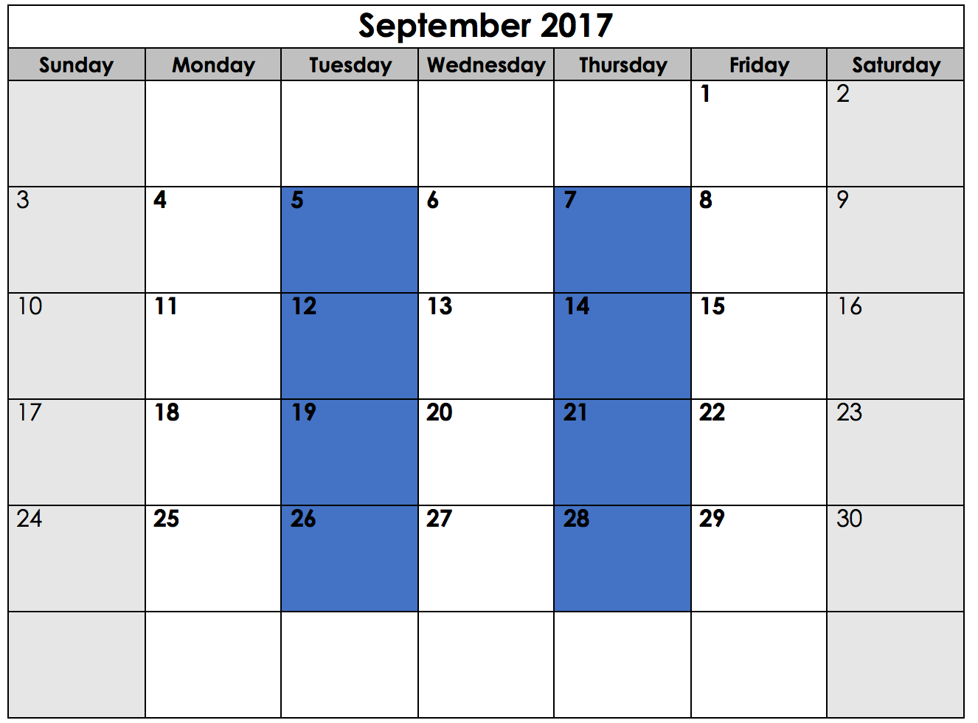
Course Schedule
Data modeling introduction
Relation Model/SQL Intro
Assignment 1b
Introduction and overview
Core concepts
Assignment 1a
Math, string operations
ORDER BY, GROUP BY, …
Assignment 1a, 1b due.
Data modeling/UML
SQL SELECT, PROJECT
Intro to DDL
Associations, Relations
JOIN(I)
Data modeling/UML
SQL SELECT, PROJECT
Intro to DDL
Assignment 2
Indices, Keys
Database modification
Cursors(I), Transactions
Assignment 2 due.
JOIN (II)
UNION
Complex examples

Slide 21
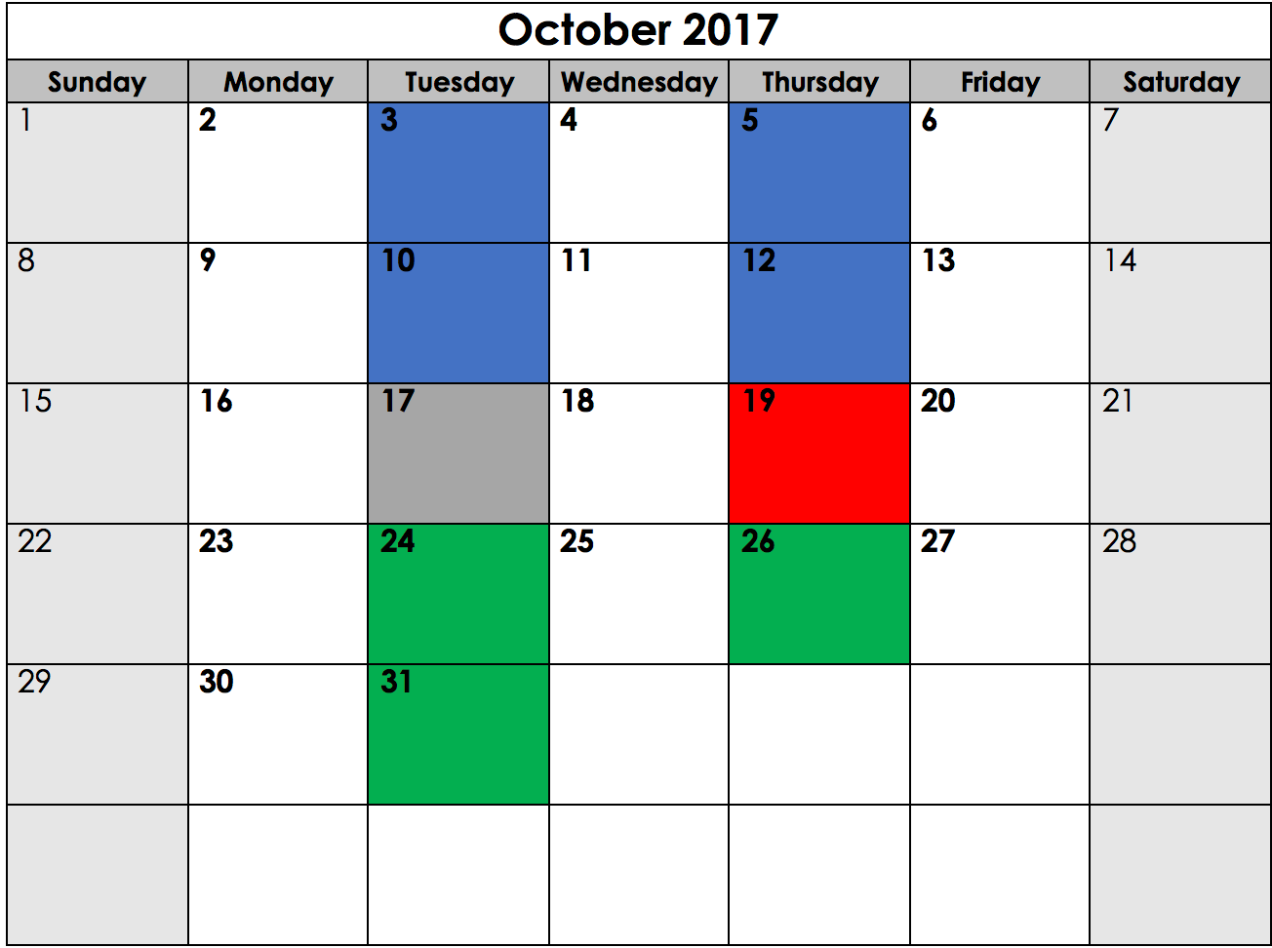
Course Schedule
Views
Complex scenarios
Constrains
Triggers
Assertions
Assignment 3
Data Modeling (II)
Relation mapping
Assignment 3 due
Sub queries
Complex scenarios
Midterm
Midterm Review
Indices
B-Trees, Hashes
Assignment 4a
Implementing DMBS
Storage management
Buffer pools
Query execution
Query algorithms

Slide 22
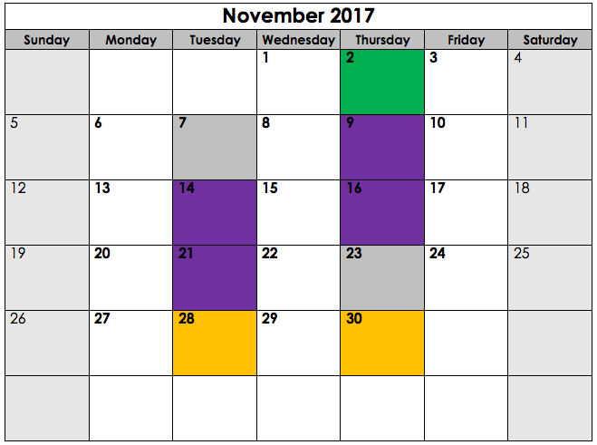
Course Schedule
Query Compilation
Query Plans
Assignment 4b
Election Break
Introduction to “No SQL” DBs
Assignment 4a, 4b due.
Document Databases
DynamoDB
Graph Databases (Neo4J)
Key/value databases
Redis
Assignment 5 due.
Thanksgiving
Database applications
REST/HATEOAS <-> DBs
Assignment 6; Assignment 5 due
Web applications (cont)

Slide 23
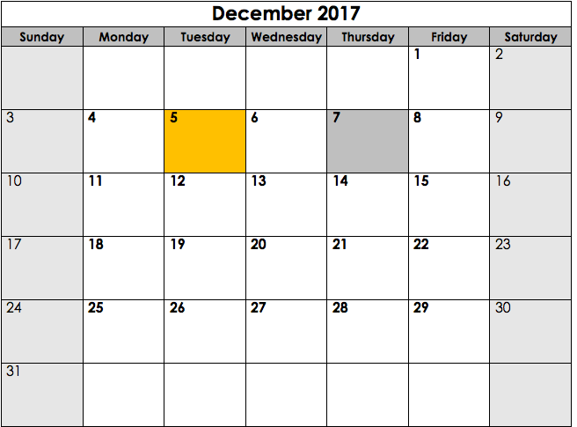
Course Schedule
Final Exam Pre/Review
Assignment 6 due.
DB/Application Design Patterns

Slide 24
Course Schedule – Plan B
Paraphrasing Sun Tzu,
“No course agenda survives first contact with the students, semester and class material.”

Slide 25
Course Schedule – Plan B
Paraphrasing Sun Tzu,
“No course agenda survives first contact with the students, semester and class material.”
Also, I have two conflicts with lectures that I could not reschedule. I will prerecord the lecture presentations for online viewing. I will compensate for the missed time with extra office hours and one-on-ones.
Will announce dates for “cancelled” lectures as soon as I have confirmed.

Slide 26
Data Databases Data Models DBMS

Slide 27
Data

Slide 28
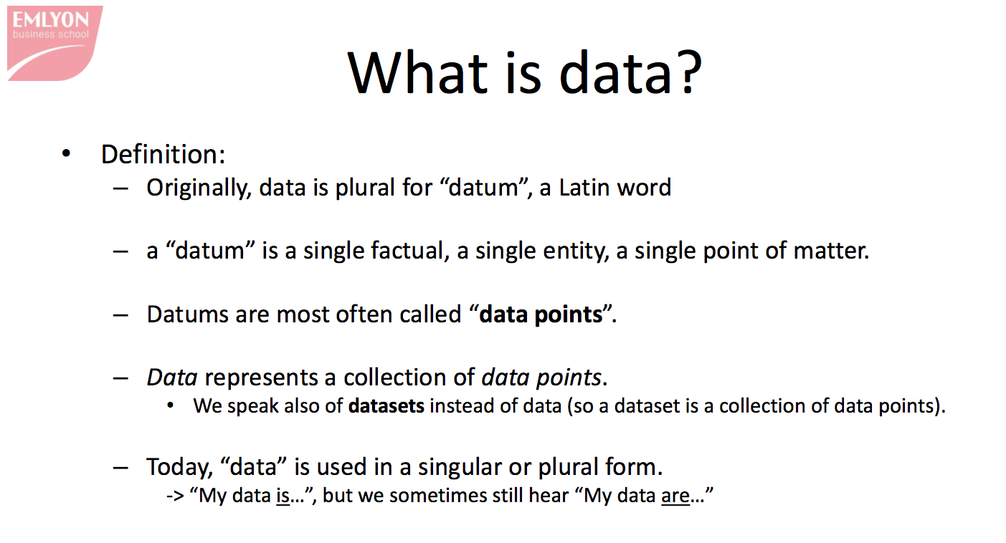
https://www.slideshare.net/seinecle/what-is-data-38295220

Slide 29
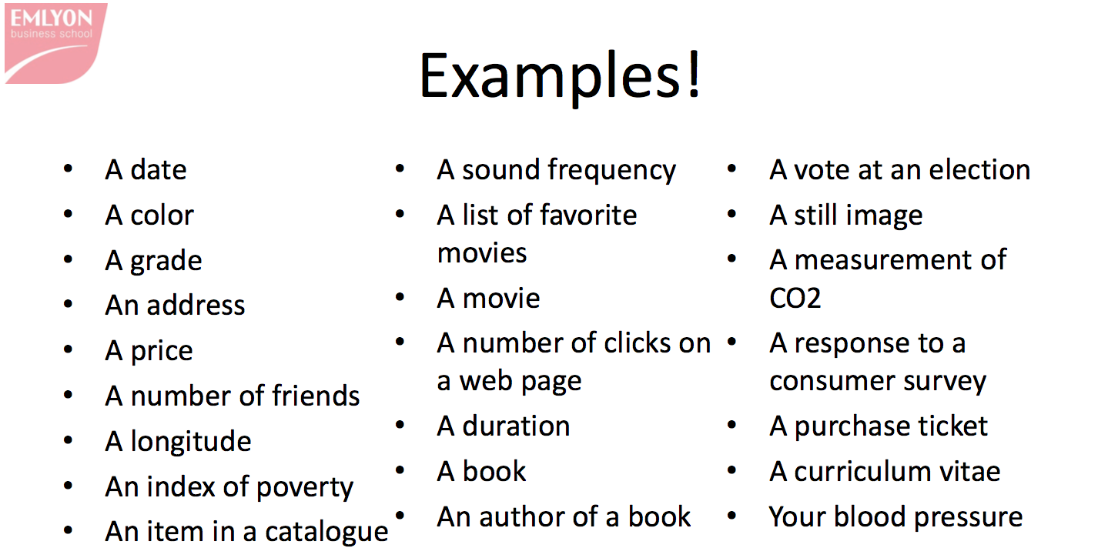

Slide 30
Some Ways to Think about Data
Structured vs. Unstructured
Data and Metadata
Metadata is "data [information] that provides information about other data". Three distinct types of metadata exist: descriptive metadata, structural metadata, and administrative metadata.
Descriptive metadata describes a resource for purposes such as discovery and identification. It can include elements such as title, abstract, author, and keywords.
Structural metadata is metadata about containers of data and indicates how compound objects are put together, for example, how pages are ordered to form chapters. It describes the types, versions, relationships and other characteristics of digital materials.
Administrative metadata provides information to help manage a resource, such as when and how it was created, file type and other technical information, and who can access it.
https://en.wikipedia.org/wiki/Metadata

Slide 31
Some Ways to Think about Data
Structured vs. Unstructured
We will focus on structured data
Need to constrain the scope for a one semester class.
Concepts are foundational and apply to semi-structured and unstructured data.
Unstructured data scenarios typically require extracting or extending with structured data.
Data and Metadata
Metadata is "data [information] that provides information about other data". Three distinct types of metadata exist: descriptive metadata, structural metadata, and administrative metadata.
Descriptive metadata describes a resource for purposes such as discovery and identification. It can include elements such as title, abstract, author, and keywords.
Structural metadata is metadata about containers of data and indicates how compound objects are put together, for example, how pages are ordered to form chapters. It describes the types, versions, relationships and other characteristics of digital materials.
Administrative metadata provides information to help manage a resource, such as when and how it was created, file type and other technical information, and who can access it.
https://en.wikipedia.org/wiki/Metadata

Slide 33
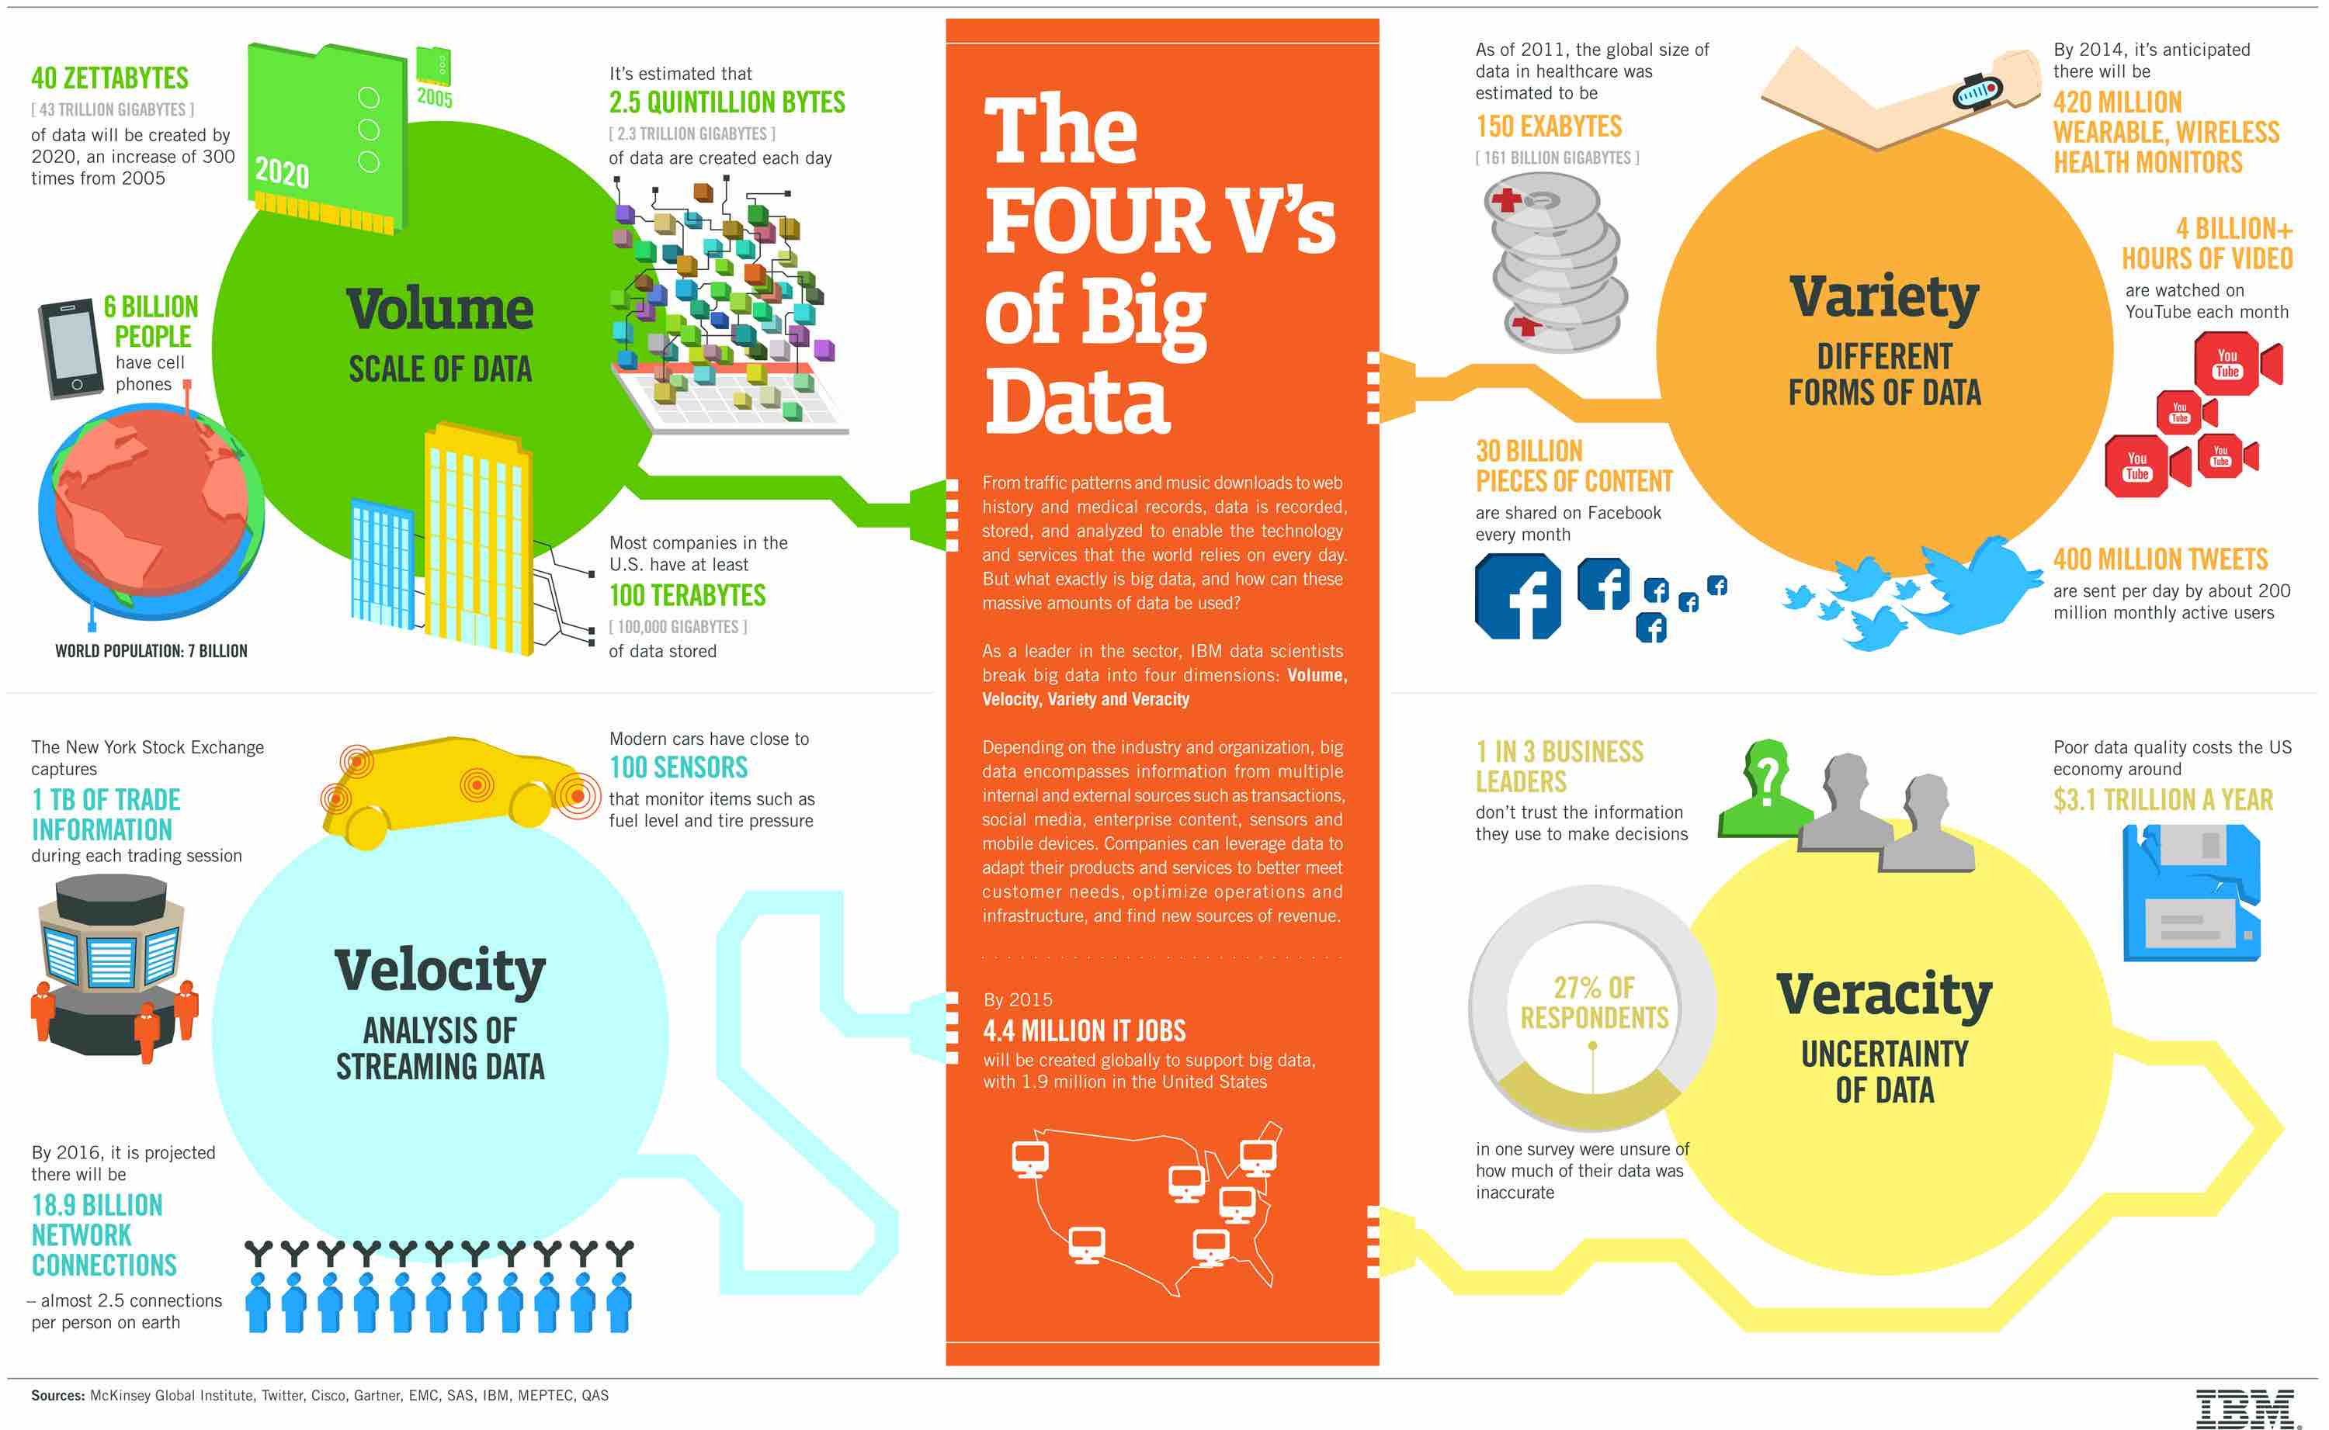
The Four V’s of Big Data

Slide 34
Or, Five V’s

Slide 35
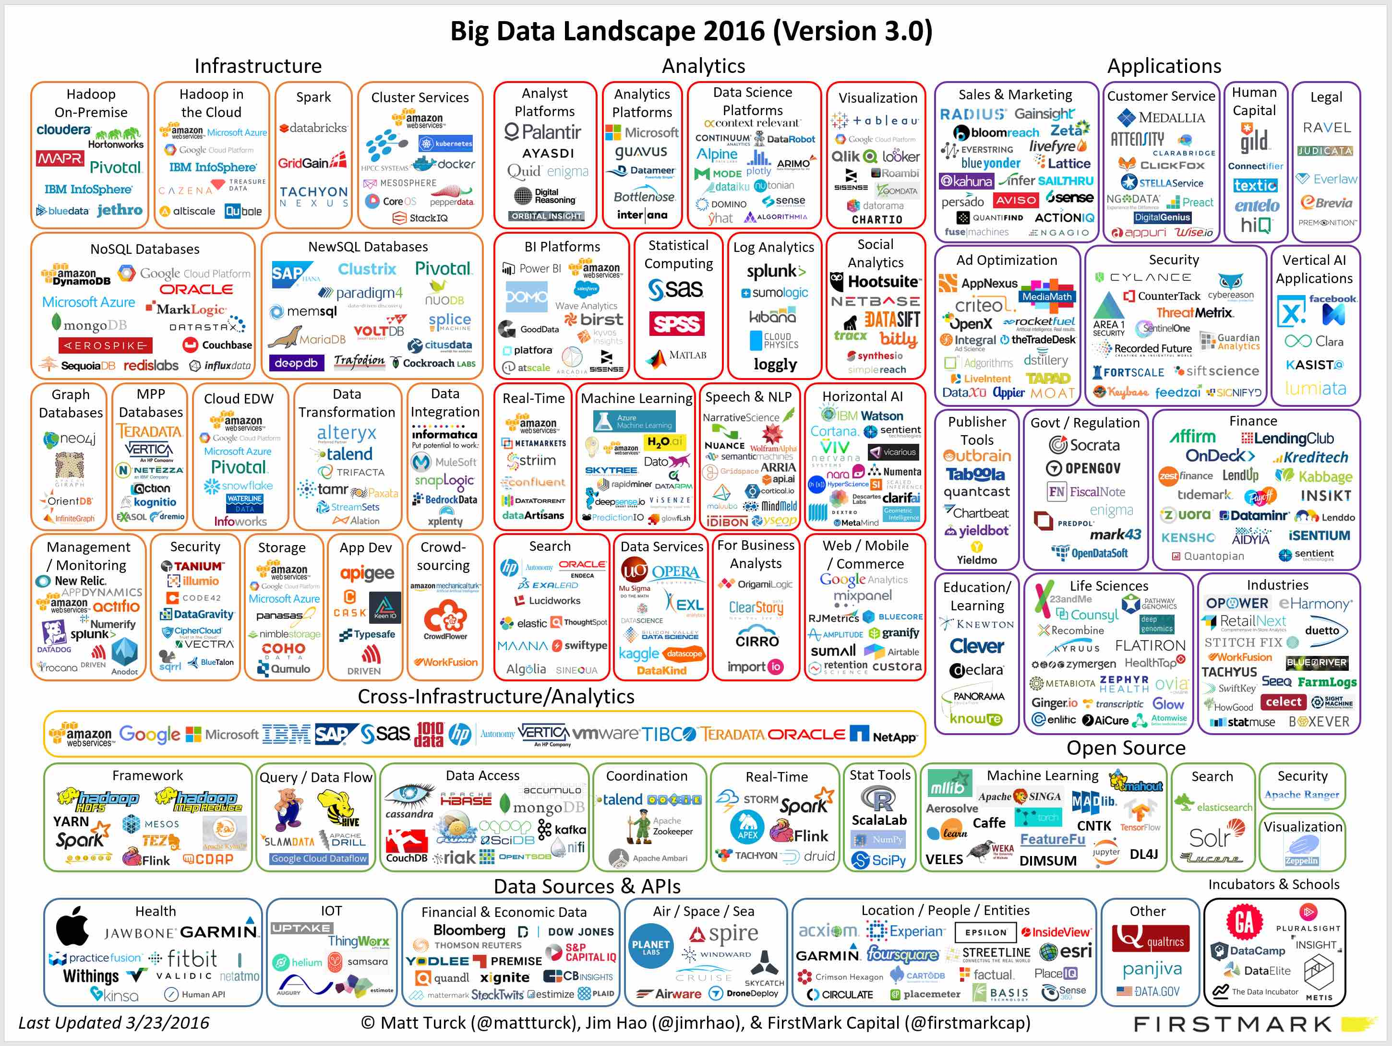

Slide 36
Databases

Slide 37
Database
“A database is an organized collection of data.^{[1]} It is the collection of schemas, tables, queries, reports, views, and other objects. The data are typically organized to model aspects of reality in a way that supports processes requiring information, such as modelling the availability of rooms in hotels in a way that supports finding a hotel with vacancies. (https://en.wikipedia.org/wiki/Database)”
“Systematically organized or structured repository of indexed information (usually as a group of linked data files) that allows easy retrieval, updating, analysis, and output of data. Stored usually in a computer, this data could be in the form of graphics, reports, scripts, tables, text, etc., representing almost every kind of information. Most computer applications (including antivirus software, spreadsheets, word-processors) are databases at their core.” (http://www.businessdictionary.com/definition/database.html)

Slide 38
Sample, VERY Simple (Structured) Database
Entity – Data about a “Thing,” e.g.
Person
Web click
Product
Fields (Properties) – The data describing, defining an entity. Often named and typed, e.g.
(Height, Integer)
(Last name, String)
Set/Collection/Table
A group of things.
Usually the same ”kind of entity”
Relationships/Associations – Links between entities, which convey sematic information, e.g.
Don IsA Professor
Don Teaches {COMS4111, COMSE6998)

Slide 39
More Complex, but still Very Simplistic

Slide 40
Data Models Data Modeling

Slide 41
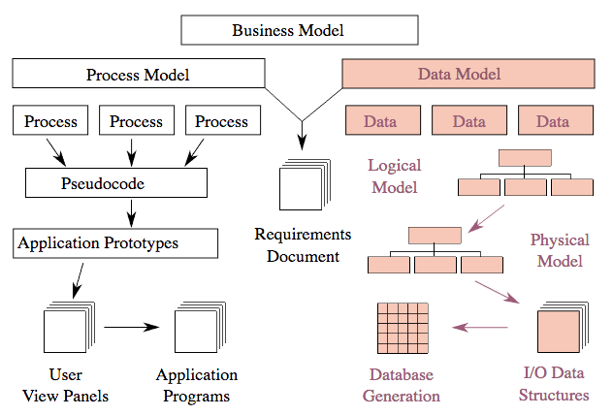
Data Models and Applications
https://en.wikipedia.org/wiki/Data_model

Slide 42
Data Modeling
“Data modeling (data modelling) is the analysis of data objects and their relationships to other data objects. Data modeling is often the first step in database design and object-oriented programming as the designers first create a conceptual model of how data items relate to each other. Data modeling involves a progression from conceptual model to logical model to physical schema.” (http://www.webopedia.com/TERM/D/data_modeling.html)
“What is a datamodel?
A data model is a notation for describing data or information. The description generally consists of three parts:
Structure of data.
Operations on the data.
Constraints on the data.”
Database Systems: The Complete Book (2nd Edition) by Hector Garcia-Molina (Author), Jeffrey D. Ullman (Author), Jennifer Widom (Author)

Slide 43
Skip the rest of modeling for now.

Slide 44
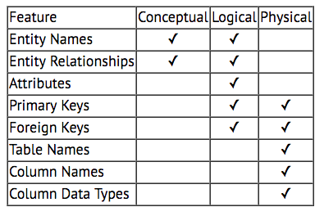
Conceptual, Logical, Physical
Increasing Detail

Slide 45
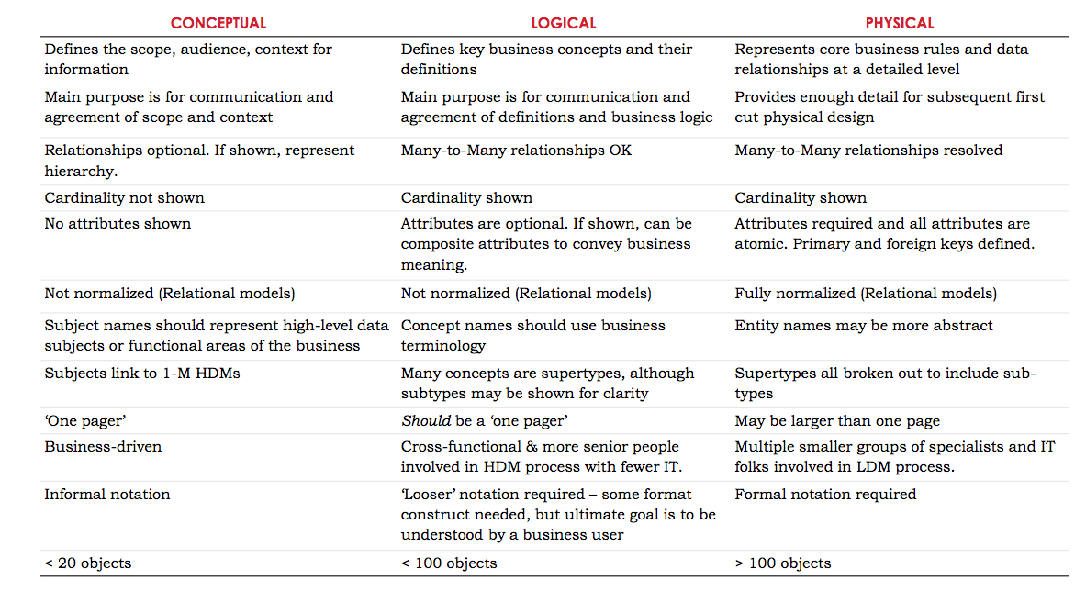
Comparison (https://www.slideshare.net/inforacer/data-modeling-for-the-business)

Slide 46
Data Modeling
Notation?
What is "a notation?"
“Data modeling (data modelling) is the analysis of data objects and their relationships to other data objects. Data modeling is often the first step in database design and object-oriented programming as the designers first create a conceptual model of how data items relate to each other. Data modeling involves a progression from conceptual model to logical model to physical schema.” (http://www.webopedia.com/TERM/D/data_modeling.html)
“What is a datamodel?
A data model is a notation for describing data or information. The description generally consists of three parts:
Structure of data.
Operations on the data.
Constraints on the data.”
Database Systems: The Complete Book (2nd Edition) by Hector Garcia-Molina (Author), Jeffrey D. Ullman (Author), Jennifer Widom (Author)

Slide 47
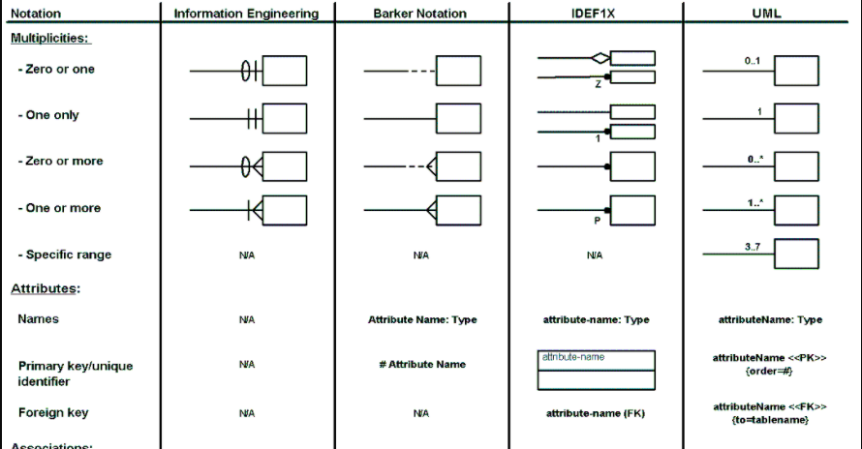
Data Modeling – Notation (www.agiledata.org)

Slide 48
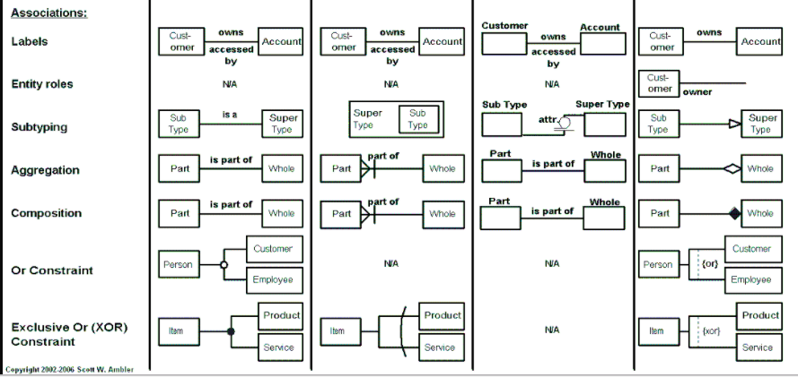
Data Modeling – Notation (www.agiledata.org)

Slide 49
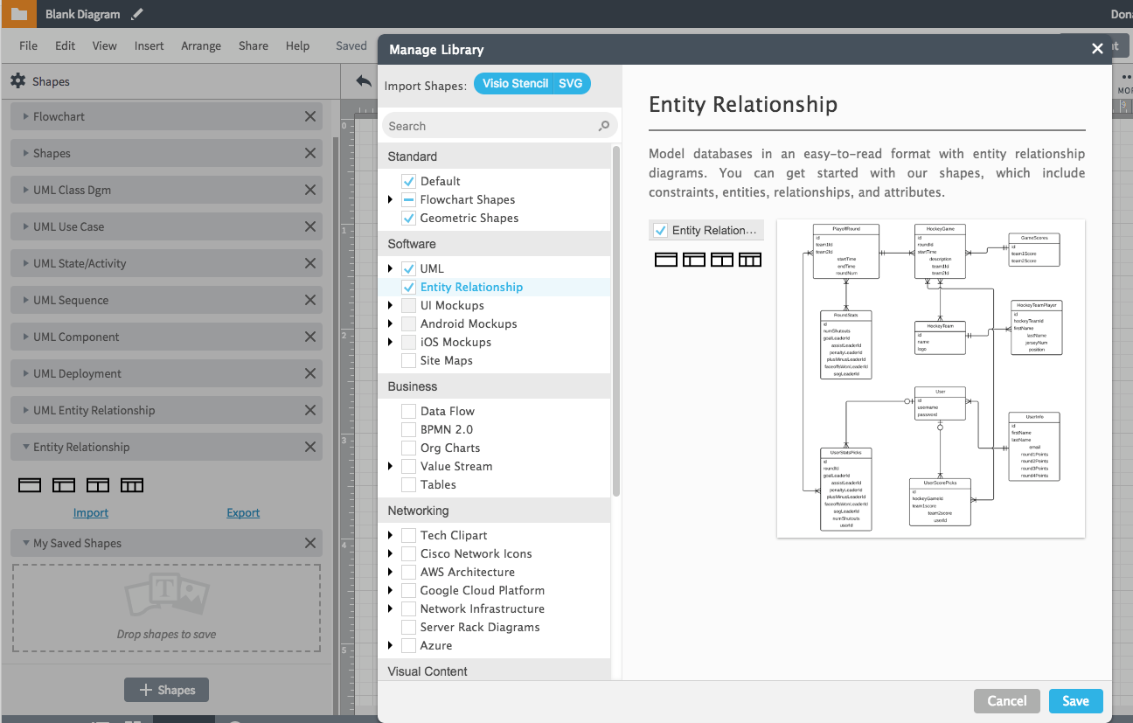
Lucidchart Example

Slide 50
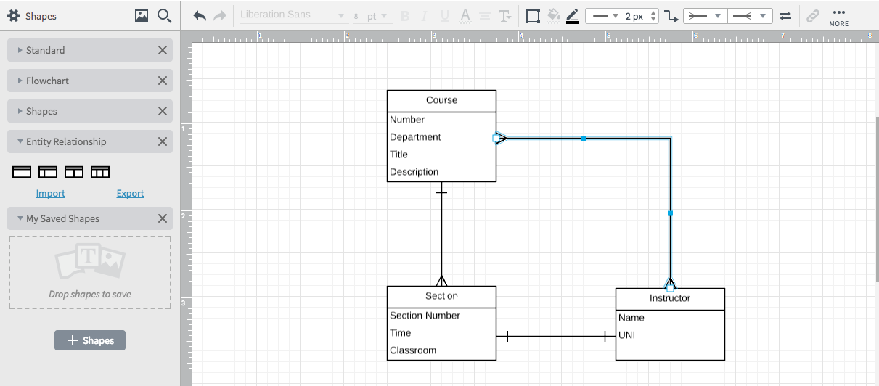
Lucidchart Example (and Demo)

Slide 51
Database Management Systems

Slide 52
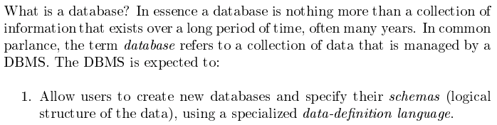
Database Management System
Database Systems: The Complete Book (2nd Edition) by Hector Garcia-Molina (Author), Jeffrey D. Ullman (Author), Jennifer Widom (Author)

Slide 53
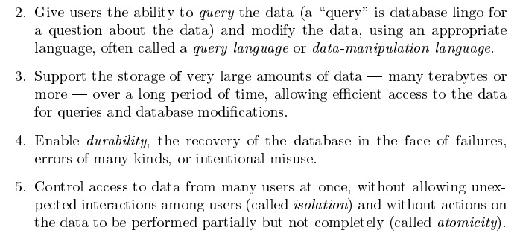
Database Management System
Database Systems: The Complete Book (2nd Edition) by Hector Garcia-Molina (Author), Jeffrey D. Ullman (Author), Jennifer Widom (Author)

Slide 54
What is the difference between a database management system and just using files, maybe with spreadsheet data?
Funny you should ask. Project 1a and 1b will demonstrate the differences.
Also, see https://www.google.com/search?q=database+vs+filesystem or Database Management Systems, 3rd Edition by Raghu Ramakrishnan, Johannes Gehrke pages 8,9.

Slide 55
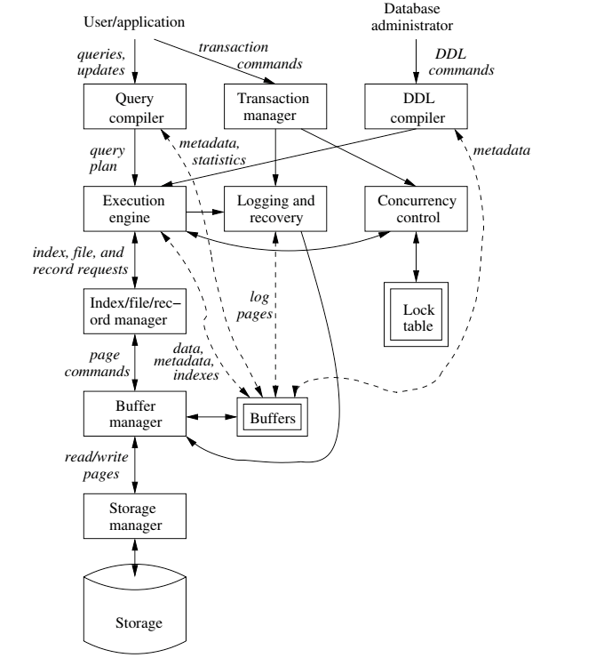
Database Mgmt. Systems

Slide 56
Assignment 1A

Slide 57
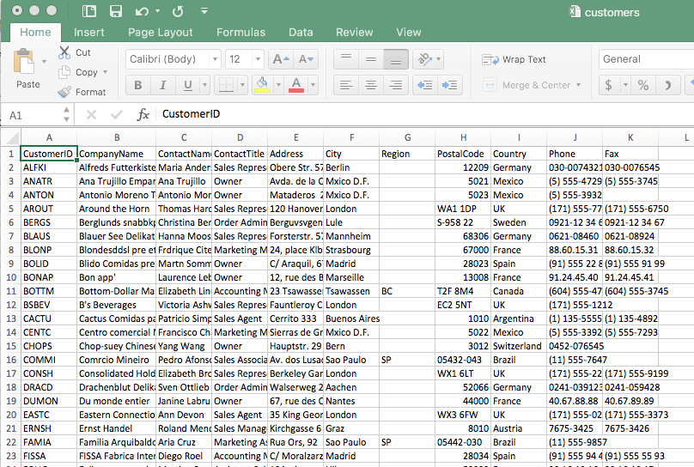
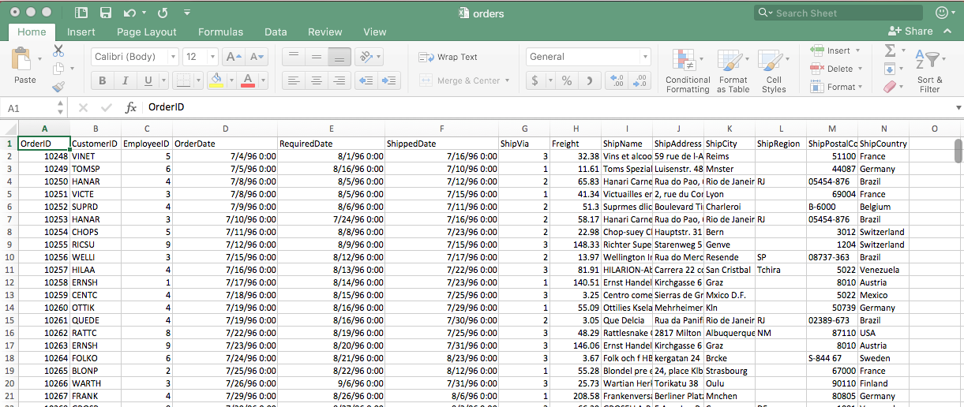
Northwinds Database (https://northwinddatabase.codeplex.com/)

Slide 58
Assignment 1a
Basic, “code” based data processing of structured data in files
orders.csv, customers.csv (https://piazza.com/class/j5tvenbo7g87ir?cid=6)
You will write a program (in any language)
Loads the data from the two files. Saves changed files when done.
Accepts a “database operation” for find or insert (from terminal/command line)
“Find customer column1=value1, column7=value2”
“Insert order (value1, value2,,value3,,,value4,,,,)”
Examples
Find order employeeID=5, shipCountry=“Brazil”
Insert customer (“ALFKI","Alfreds Futterkiste","Maria Anders","Sales Representative","Obere Str. 57","Berlin","","12209","Germany","030-0074321","030-0076545”)
Install or signup for a relational database.
I will use MySQL and MySQL Workbench (https://dev.mysql.com/downloads).
Other popular ones are AWS RDS, Microsoft SQL Server Express

Slide 59
Assignment 1a
Basic, “code” based data processing of structured data in files
orders.csv, customers.csv (https://piazza.com/class/j5tvenbo7g87ir?cid=6)
You will write a program (in any language)
Loads the data from the two files. Saves changed files when done.
Accepts a “database operation” for find or insert (from terminal/command line)
“Find customer column1=value1, column7=value2”
“Insert order (value1, value2,,value3,,,value4,,,,)”
Examples
Find order employeeID=5, shipCountry=“Brazil”
Insert customer (“ALFKI","Alfreds Futterkiste","Maria Anders","Sales Representative","Obere Str. 57","Berlin","","12209","Germany","030-0074321","030-0076545”)
Install or signup for a relational database.
I will use MySQL and MySQL Workbench (https://dev.mysql.com/downloads).
Other popular ones are AWS RDS, Microsoft SQL Server Express
What do you submit? A zip file containing
The source code for your application.
Screen recording of your programs execution on at least 3 example each of Find and Insert.
Where do you submit it? CourseWorks.

